Slide 1
Foundations of Neural Networks
https://shorturl.at/rN1Jj

Slide 2
Outline
Today
Basics of Machine Learning
Neural Network Fundamentals
NNs for Images
Tomorrow
NNs for Text
Spiking NNs
Explainability & Bias

Slide 3

Python Environment
Colab
Local Machine
Bede
https://drive.google.com/drive/folders/1SGPLwr2LlL7VSL_QvEUW_6OmL4G2ZObb?usp=drive_link
https://shorturl.at/rN1Jj
Notes:
So hopefully that sets the scene.
There are lots of ways you can run machine learning on. We’re going to use google’s colab for the demos today because it’s preconfigured with a standard set of libraries.
If you want to do this on larger data using better models later, try running it on machines with bigger GPUs.

Slide 4
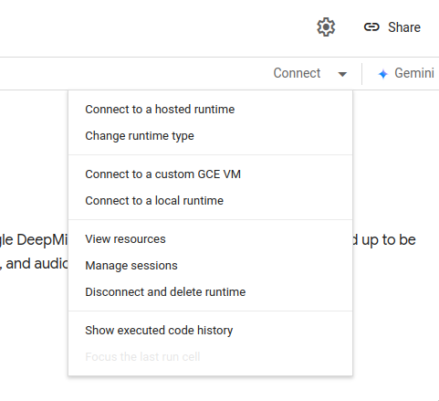
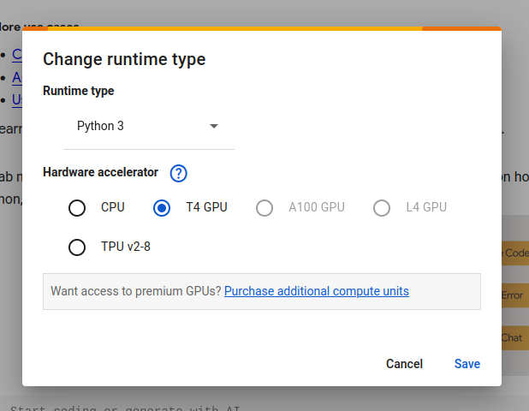
GPU Runtime

Slide 5
1: Basics of Machine Learning

Slide 6
Artificial Intelligence
Machine
Learning
Deep Learning/ Neural Networks
Notes:
AI - Machines that mimic human intelligence
ML - Algorithms that learn from data - systems which optimize themselves
Deep Learning - ML that uses a specific type of algorithm - Neural Networks

Slide 7
Types of ML
Unsupervised
Supervised
Notes:
Unsupervised Learning
Doesn’t need labels (supervision)
Usually means clustering methods (learning to group data together)
E.g. if you have a load of news articles and want to find which are talking about the same topic
Supervised Learning
Needs labels
The image is an example of classification, but we can also do regression (predicting a value, e.g. if x,y,z changes can I predict the effect on the price of my house).
Neural Networks are an example of a supervised method and is what we’ll focus on here

Slide 8
Reinforcement Learning
Notes:
Reinforcement learning involves developing an agent which learns to interact with an environment . This is typically used for robotics applications.

Slide 9
ML Tasks
Classification
Binary
Multi-class
Regression
Notes:
Classification
Assigning a label to something
E.g. Is this picture of a dog or a cat?
Regression
Predicting a value for something
E.g. Given the location, number of bedrooms - how much is my house worth?
There are also other tasks such as image segmentation, text generation but we’ll touch on those later. For now we’ll focus on the most common task - classification

Slide 10
Basic ML Process
Dataset
Datasets
Training
Models
Training
Trained Model
Notes:
There are some standard things we need when we do supervised classification
Firstly we need a dataset. For most ML methods (especially neural networks) the bigger the better. As we’re doing supervised learning this should be labelled with the classes you want to predict.
Then we perform training which uses the dataset to optimize.
The result of this training is a model which has learned how to classify the examples.

Slide 11
Datasets
Train/Test Split
Dataset
Train
Test
Notes:
We need to split our dataset into training and test sets. Just like how in an exam you’re given a different (but related) problem to solve - not just one copied out of the textbook
Commonly we use a much larger set for training than testing as it’s more data-intense (usually 80%-20% or 90%-10%)

Slide 12
Simple Weather Dataset
Cloud cover | Temperature | Picnic?
10% | 23.5 | Yes
70% | 8.7 | No
… | … | …

Slide 13
Metrics
Accuracy
Precision
Recall
F1-Score
Notes:
Then we need some metrics - measures we can use to put a number on how well our model is doing

Slide 14
Metrics
Labels | Model
Picnic | Picnic
No Picnic | No Picnic
No Picnic | No Picnic
No Picnic | No Picnic
Picnic | No Picnic
No Picnic | Picnic
Notes:
Let’s look at an example. Imagine we have the correct labels alongside the model’s prediction. We want to apply some metrics to evaluate how good the model is.

Slide 15
Accuracy
Labels | Model
Picnic | Picnic ✅
No Picnic | No Picnic ✅
No Picnic | No Picnic ✅
No Picnic | No Picnic ✅
Picnic | No Picnic ❌
No Picnic | Picnic ❌
Accuracy: 4/6 = 66.7%
Notes:
An obvious choice is accuracy
What proportion of the examples did we get right.
Use as a rough indicator of model training progress/convergence for balanced datasets.
For model performance, use only in combination with other metrics.
There are problems with accuracy though. Especially if your dataset is very unbalanced or you care about getting one class right more than another.

Slide 16
Precision
Labels | Model
Picnic | Picnic ✅
No Picnic | No Picnic
No Picnic | No Picnic
No Picnic | No Picnic
Picnic | No Picnic
No Picnic | Picnic ❌
Precision: 1/2 = 50%
Notes:
Another measure we can use is precision. Of the examples the model labelled as the positive class (Picnic) how often are they actually “Picnic”.

Slide 17
Recall
Labels | Model
Picnic | Picnic ✅
No Picnic | No Picnic
No Picnic | No Picnic
No Picnic | No Picnic
Picnic | No Picnic ❌
No Picnic | Picnic
Recall: 1/2 = 50%
Notes:
Recall - If there’s an example which should be labelled as picnic, how often does the model correctly identify it as “picnic”.

Slide 18
F1-Score
Precision x recall
F1-Score = 2
Precision + recall
Notes:
If we want a well-rounded model, we want both high precision and high recall. We can use the F1-score which is the harmonic mean of precision and recall

Slide 19
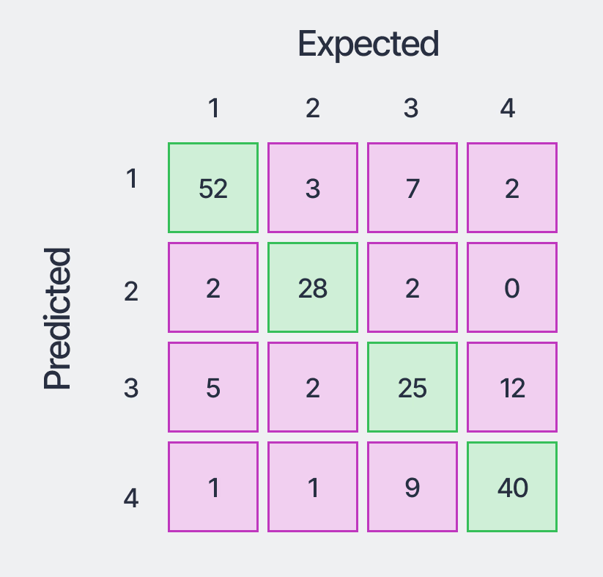
Confusion Matrix
Notes:
Typically if we have multiple classes we’ll look at a confusion matrix which shows us what classes the model got ‘confused’

Slide 20
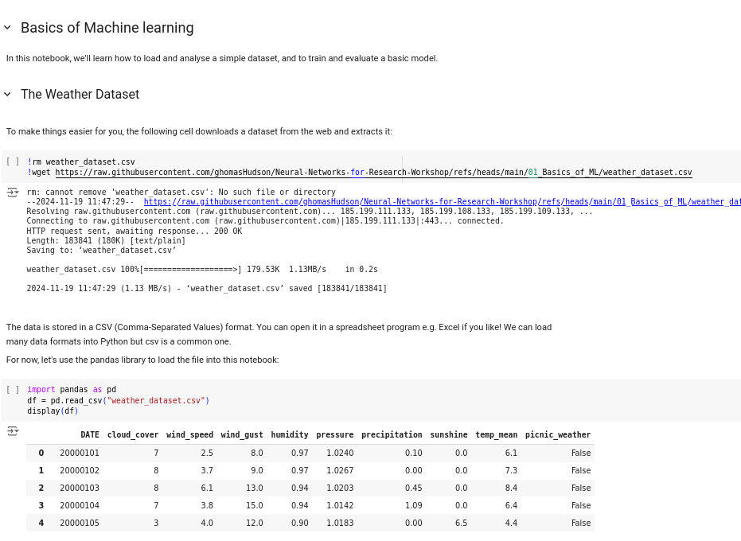
Notebook 1: Evaluating an ML Model
01 Basics of ML/Notebook 1: Evaluating an ML Model.ipynb

